Slide 1
BSS Overview
- Prakash Kajave

Slide 2
Objectives
At the end of this session, you will be able to:
  Explain the functionality of CRM system & its sub components
  Understand billing system composition
  Understand Product and service modeling
  Appreciate rating differentiators and discounts
  Describe how rating & billing works
  Explain mediation and its functionality
  List different payment transactions and narrate dunning actions
  Appreciate the need of revenue assurance
  Map BSS systems with eTOM model
  List few telecom COTS products in BSS area
CONFIDENTIAL© Copyright 2007 Tech Mahindra Limited

Slide 3
Agenda
eTOM BSS Intersection
CRM and its constituents
Billing system composition
Mediation
Accounting: Receivables, Dunning / Collections
Revenue Assurance and Fraud Management
COTS products in BSS space
CONFIDENTIAL© Copyright 2007 Tech Mahindra Limited

Slide 4
eTOM BSS Intersection

Slide 5
eTOM Level 0 – Conceptual View
Plan
The
Business
Customer
Manage
The
Business
Strategy, Infrastructure and
Product
Operations
Run
The
Business
Suppliers / Partners
Enterprise Management
Shareholders
Employees
Other Stakeholders
CONFIDENTIAL© Copyright 2007 Tech Mahindra Limited

Slide 6
eTOM Level 0 – Operations
Plan
The
Business
Customer
Manage
The
Business
Strategy, Infrastructure and
Product
Operations Area
Expanded
Run
The
Business
Suppliers / Partners
Enterprise Management
Shareholders
Employees
Other Stakeholders
CONFIDENTIAL© Copyright 2007 Tech Mahindra Limited

Slide 7
BSS Intersection eTOM (Level 2)
CRM
Operations
Operations Support & Readiness
Fulfillment
Assurance
Billing
Customer Relationship Management
Customer Interface Management
Selling
Customer QoS/ SLA Management
Billing & Collections Management
Marketing Fulfillment
Response
Problem Handling
CRM Support & Readiness
Order Handling
Retention & Loyalty
Service Management & Operations
Service Configuration & Activation
Service Problem Mgmt
Service Quality Management
SM&O Support & Readiness
Service Configuration & Activation
Service Problem Management
Service Quality Mgmt
Service & Specific Instance Rating
SM&O Support & Readiness
Resource Management & Operations
Resource Trouble Mgmt
Resource PerformanceMgmt
Resource Trouble Mgmt.
Resource Performance Mgmt.
RM&O Support & Readiness
Resource Provisioning
RM&O
Support &
Readiness
Resource
Provisioning
Resource Data Collection & Processing
Resource Data Collection and Processing
Supplier/Partner Relationship Management
S/P Purchase Order Management
S/P Problem Reporting & Management
S/P Performance Management
S/P Settlements & Billing Management
S/PRM Support & Readiness
Billing
S/P Buying
Retention & Loyalty
CONFIDENTIAL© Copyright 2007 Tech Mahindra Limited
Notes:
Illustrates what we have just discussed in terms of focus areas within the OSS space.
Billing, mediation, CRM systems, RA and Fraud Management, for example, are addressed through our Business Support Systems CSU.
When viewed from outside this will not be visible to customers – seamless integration.

Slide 8
Customer Relationship Management (CRM)

Slide 9






What is CRM?
Customer Relationship Management
Beyond mere ‘Contact Management’, rather customer expectation management or customer experience management
What’s needed to enhance customer satisfaction from CRM system perspective?
  People, Process and Technology
Welcome Sir,
We have different Plans for IPTV available…
Which plan are you looking
for?
Product Catalog
Wireline
Product A
Product B
Wireless
Product A
Product B
IPTV
Silver 1000
CONFIDENTIAL© Copyright 2007 Tech Mahindra Limited
Notes:
CRM stands for Customer Relationship Management and is common and important concept in many industries
CRM covers a number of functions the service provider needs to support to maintain contact with the customers since the beginning of the relationship with the customer.
Rather it is beyond mere ‘Contact Management’, rather customer expectation management or customer experience management
These processes need to be effectively integrated with the back end processes to ensure that the information about the customer and their preferences and behaviour is effectively understood to anticipate the needs to provide the value.
What’s needed to enhance customer satisfaction from CRM system perspective ?
People , Process and Technology : All three need to contribute towards enriched customer experience

Slide 10
Where does CRM fit in the eTOM Model?
C U S T O M E R
Strategy, Infrastructure & Product
Operations
Strategy &
Infrastructure
Product
Operations
Fulfillment
Assurance
Billing
Commit
Lifecycle
Lifecycle
Support and
Management
Management
Readiness
Marketing & Offer Management
Customer Relationship Management
Service Development & Management
Service Management & Operations
Resource Development and Management
Resource Management & Operations
(Application, Computing and Network)
(Application, Computing and Network)
Supply Chain Development and Management
Supplier/Partner Relationship Management
Enterprise
Management
Strategic &
Brand Management,
Stakeholder & External
Disaster Recovery,
Enterprise
Market Research &
Relations Management
Security & Fraud
Planning
Advertising
Management
Financial & Asset
Human Resources
Research &
Enterprise Quality
Management
Management
Development,
Management, Process & IT
Technology
Planning & Architecture
Acquisition
CONFIDENTIAL© Copyright 2007 Tech Mahindra Limited

Slide 11
Where does CRM fit in the eTOM Model?
C U S T O M E R
Strategy, Infrastructure & Product
Operations
Strategy &
Infrastructure
Product
Operations
Fulfillment
Assurance
Billing
Commit
Lifecycle
Lifecycle
Support and
Management
Management
Readiness
Marketing & Offer Management
Customer Relationship Management
Service Development & Management
Service Management & Operations
Resource Development and Management
Resource Management & Operations
(Application, Computing and Network)
(Application, Computing and Network)
Supply Chain Development and Management
Supplier/Partner Relationship Management
Enterprise
Management
Strategic &
Brand Management,
Stakeholder & External
Disaster Recovery,
Enterprise
Market Research &
Relations Management
Security & Fraud
Planning
Advertising
Management
Financial & Asset
Human Resources
Research &
Enterprise Quality
Management
Management
Development,
Management, Process & IT
Technology
Planning & Architecture
Acquisition
CONFIDENTIAL© Copyright 2007 Tech Mahindra Limited

Slide 12


CRM Functionalities
  Customer Information Management
Sales Mgmt & Marketing Mgmt
Product & Service Mgmt
CRM
Enquiry – Order , Billing, Payment
Service Request
Service Complaints
CONFIDENTIAL© Copyright 2007 Tech Mahindra Limited
Notes:
Customer care covers a number of functions the service provider needs to support to maintain contact with the customer since the beginning of the relationship with the customer.
These processes need to be effectively integrated with the back end processes to ensure that the information about the customer and their preferences and behavior is effectively understood to anticipate the needs to provide the value.
Typical functions in the areas of Customer Care are:
Customer Information Management
Products and Service Information Management
Service Request
Service Complains and Questions (Trouble Tickets)
Billing Inquiry
Customer Information/Support Management includes the following features to help support center proactively service customers
It enables support representatives to
Respond to customer calls
Record problem information
Maintain customer configurations
Dispatch Field Engineers to customer sites
Create service requests
It enables managers to
Run reports, Queries & Trends to review information
Drive business policies and determine workflow
Customer feedback brought deeper into organization
Customer satisfaction as differentiator
It enables knowledge workers
Create Solutions to assist in problem solving
Review/maintain Solutions created by others
Write style guides and train others on Solution creation

Slide 13
CRM: Silent Features
Single view from customer perspective for everything
  Order, Query as well as complaint
Takes care of Customer and Service lifecycle management
Holistic & 360 degree view of customer
  Useful for CSR, Sales and Marketing people apart from others
Sales and Marketing Management at times integrated
Source for BI, RA and lot other systems
CONFIDENTIAL© Copyright 2007 Tech Mahindra Limited

Slide 14
CRM: Goal
Customer Perspective
Customer Loyalty
  Personalized service
  Service Level Norms
Customer Responsiveness
  For your eyes only
    24 x 7 x 365
  Self-service & Self-sales
Organization's Perspective
Customer Information Repository
  Up selling & Cross selling
  Entitlement Management
Employee Productivity
  Empower by knowledge
  Improve Office Environment
  Virtual Office
CONFIDENTIAL© Copyright 2007 Tech Mahindra Limited

Slide 15
CRM Functional Areas
Customer Service
  Technical Support Management
  Trouble calls, questions, service requests
  Problem Resolution System
Call Centre Operations
  Call Routing
  Telemarketing
Contract Management
  Entitlement information management
  Renewals
Interaction Management
  Channels of Communication
Knowledge Management
  Problem Resolution Systems
Sales Force Automation
Marketing Management
CONFIDENTIAL© Copyright 2007 Tech Mahindra Limited

Slide 16
CRM: Sales Management
Sales leverages the information on customers from business intelligence systems with data warehousing and mining capabilities
Typical Functionalities under Sales Management
  Sales Team and Geography sales planning
  Lead → Opportunity → Account Management
  (Journey of Prospect till Active Customer Account)
  Analysis and Reporting
    Dash board / Score card of individual task force in team
CONFIDENTIAL© Copyright 2007 Tech Mahindra Limited
Notes:
Sales module helps local and remote sales and marketing professionals work in a business-to-business or relationship selling environment to discover and win opportunities
Opportunity management system
Assembling of contact, account, product and competitive information into meaningful framework for managing leads and opportunities
Lead Management
Track the leads generated in a sales campaign in terms of resulting revenue
Territory Management
The roles and responsibilities of sales people are used to manage access to the information
Pipeline Management
Tracking of new lead which has entered in CRM pipeline till it is closed-successful or lost
Revenue forecasting
Forecast sales targets and quotas and monitor progress of these targets
Complex quotation management
Each quote is linked to opportunity, allowing sales organization to go for opportunity based selling process

Slide 17








Sales Management in MSDCRM
A prospect requests
more information
via the web.
A lead is created with
the appropriate
sales workflow.
The lead is passed to the right sales person to close the opportunity.
The lead is automatically
routed to inside sales
to qualify and assign.
CONFIDENTIAL© Copyright 2007 Tech Mahindra Limited

Slide 18
CRM: Marketing Management
Marketing function leverages the information on customers from business intelligence systems with data warehousing and mining capabilities
Typical functions under Marketing Management
  Campaign Management
    Planning a Campaign: Objective, Goal, Budget, Expected ROI
    Execute a Campaign
    Track Campaign Reponses
    End a Campaign
    Analyze the success of Campaign
  Target Customer Set: For whom the campaign is run
    Segmentation Analysis
  Target Product Catalog: Which products to float under campaign
Distribution of Tasks, Monitoring execution of tasks, Accountability are major functionalities involved throughout
CONFIDENTIAL© Copyright 2007 Tech Mahindra Limited

Slide 19




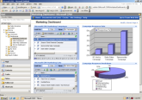

Marketing Management in MSDCRM
Campaign responses
are captured;
ROI is tracked
and reported continuously
A new campaign is
budgeted, approved,
targeted, and executed across multiple channels
CONFIDENTIAL© Copyright 2007 Tech Mahindra Limited

Slide 20
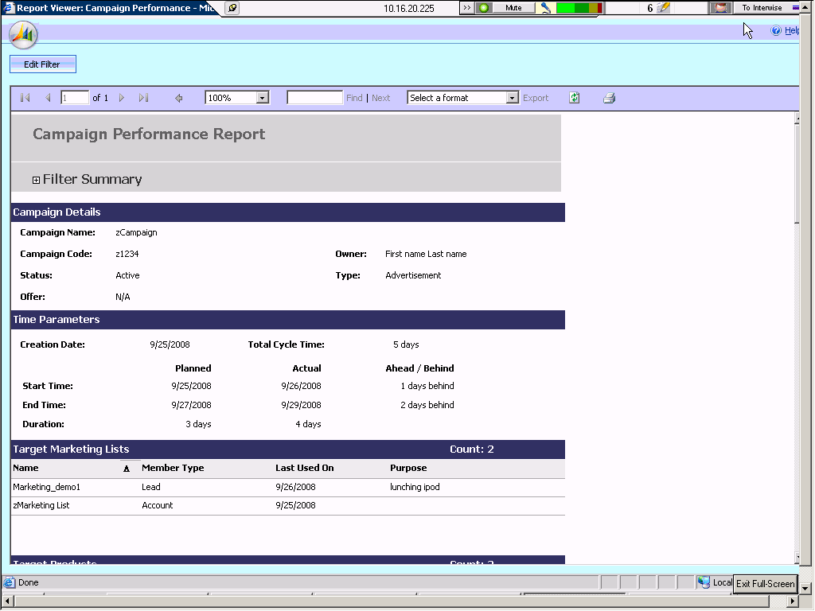
Campaign Performance Report
CONFIDENTIAL© Copyright 2007 Tech Mahindra Limited

Slide 21
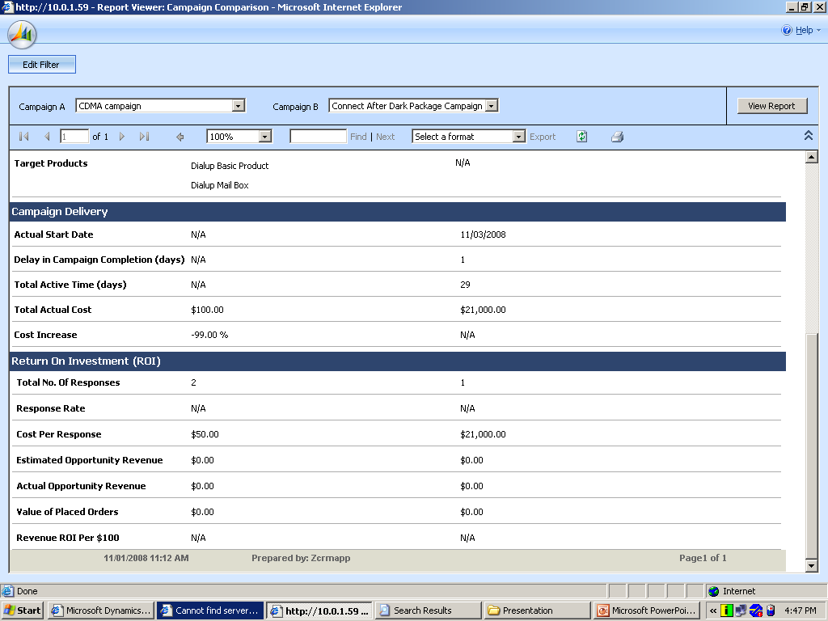
Campaign Comparison Report
CONFIDENTIAL© Copyright 2007 Tech Mahindra Limited

Slide 22
CRM : Key things to remember
Center of focus: Customer than Product
Multi-channel
  Multiple Channels of communication:
  Examples: Web, Chatting, Email, Telephone, Walk down,
Customer Lifetime Value (Loyalty)
  The potential value of the customer to the company, from the time s/he becomes a customer to the time s/he stops being one
Great source for BI
In today’s world more efforts are required to RETAIN a customer than EARN a customer
CONFIDENTIAL© Copyright 2007 Tech Mahindra Limited
Notes:
Customer Centricity
Making sure that all customer operations and systems give the company a spherical view of the customer.
Allowing the customer to seamlessly interact with all company departments, and through all channels, without loss of information or having to provide same information again.
Multi-channel
Multiple Channels of communication:
Examples: Web, Chatting, Email, Telephone, Walk down,
Customer Lifetime Value
The potential value of the customer to the company, from the time s/he becomes a customer to the time s/he stops being one
In today’s world more efforts are required to RETAIN a customer than EARN a customer

Slide 23




CRM : Major Tier 1 Vendors
Various vendors have there CRM products in the market
CONFIDENTIAL© Copyright 2007 Tech Mahindra Limited

Slide 24
Rating & Billing

Slide 25





Billing System: Nut and Bolts
Billing
Engine
Customer
Mgmt
Customer
Product
Rating
Engine
Tariff
Collections
Billing
Discount
Mgmt
Bill
Formatting
Product
Mgmt
Price
Mgmt
Payment
Discounting
CONFIDENTIAL© Copyright 2007 Tech Mahindra Limited
Notes:
Billing function relates to billing the customers for the services used
The systems supporting this function prepares the bill for the customers based on the nature of the services provided and the commercial terms agreed.
Key Elements of Billing:
Usage Data Collection from the network in a reliable and auditable manner
Rating – assign charge for individual calls or instances of service usage
Pricing and Discounting based on overall commercial contract
Bill preparation for each customer or account
Bill design and formatting
Bill print, stuff and mail
Remittance/Payment processing
Collections

Slide 26
Where does Billing fit in the eTOM OSS Model?
C U S T O M E R
Strategy, Infrastructure & Product
Operations
Strategy &
Infrastructure
Product
Operations
Fulfillment
Assurance
Billing
Commit
Lifecycle
Lifecycle
Support and
Management
Management
Readiness
Marketing & Offer Management
Customer Relationship Management
Service Development & Management
Service Management & Operations
Resource Development and Management
Resource Management & Operations
(Application, Computing and Network)
(Application, Computing and Network)
Supply Chain Development and Management
Supplier/Partner Relationship Management
Enterprise
Management
Strategic &
Brand Management,
Stakeholder & External
Disaster Recovery,
Enterprise
Market Research &
Relations Management
Security & Fraud
Planning
Advertising
Management
Financial & Asset
Human Resources
Research &
Enterprise Quality
Management
Management
Development,
Management, Process & IT
Technology
Planning & Architecture
Acquisition
CONFIDENTIAL© Copyright 2007 Tech Mahindra Limited

Slide 27
Where does Billing fit in the eTOM OSS Model?
C U S T O M E R
Strategy, Infrastructure & Product
Operations
Strategy &
Infrastructure
Product
Operations
Fulfillment
Assurance
Billing
Commit
Lifecycle
Lifecycle
Support and
Management
Management
Readiness
Marketing & Offer Management
Customer Relationship Management
Service Development & Management
Service Management & Operations
Resource Development and Management
Resource Management & Operations
(Application, Computing and Network)
(Application, Computing and Network)
Supply Chain Development and Management
Supplier/Partner Relationship Management
Enterprise
Management
Strategic &
Brand Management,
Stakeholder & External
Disaster Recovery,
Enterprise
Market Research &
Relations Management
Security & Fraud
Planning
Advertising
Management
Financial & Asset
Human Resources
Research &
Enterprise Quality
Management
Management
Development,
Management, Process & IT
Technology
Planning & Architecture
Acquisition
CONFIDENTIAL© Copyright 2007 Tech Mahindra Limited

Slide 28
Product and Service Modeling
Parent Vs Child service
Mandatory Vs Optional service
Network Vs Non Network service
Value added service
Product Catalog
Wireline
Product A
Product B
Wireless
Product A
Product B
GPRS
Silver 1000
CONFIDENTIAL© Copyright 2007 Tech Mahindra Limited

Slide 29


Service Tariff: Types of Charges
Usage
Non Usage
Pay for what u use
One Time
Installation Fee
Setup fee etc.
Which service
What time / day
Recurring
Where is call made
How long
Bill Frequency
CUG / NCUG
Proration vs Advance charge
Friends and Family
…
Event Based
Change SIM, Mob
Rate Plan Change
CONFIDENTIAL© Copyright 2007 Tech Mahindra Limited

Slide 30
Rating Differentiators
Time Based
Distance Based
Peak, Off Peak time
Day, Evening, Night time
Week day, Week end day
Holiday special rate
Local
STD, ISD
Toll Free
On Net, Off Net
More u call less charged
Services
Linear vs. Non linear charging
Network
  Voice, SMS, MMS, data, video
Non Network (VAS)
Unit of Charging
Seconds, MB, per click, per view
CONFIDENTIAL© Copyright 2007 Tech Mahindra Limited
Notes:
Local
Long distance
Regional
National
International
Direct dialing
Operator assisted
Person to person
Collect
Third number
Calling card
Credit card
POTS
Toll free
Premium (900)
CUG, VPN
Centrex, PBX
Conference call
Mobile airtime
Data (fax, packets)
Messaging
VMS, SMS, MMS
Video
Merchant, Partner
Could be anything...
Per message (e-mail, unified messaging)
Per minute telephony, video conferencing
Per MB (wireless LAN access, disk storage…)
Per view (video-on-demand)
Per kWh or equivalent (electricity, gas)
Per litre (water)
Per ticker symbol (WAP stock quotes)
Per click (click-through advertising)
Per seat (software application rental)
Per $ (commission on purchase)
Per bullet (interactive games)
Per touchdown (sports update video clips)
COULD BE COMPLEX...
Voice – per minute, geography, time of day, call type…
SMS, e-mail, UM – per message, MT/MO…
Mobile data – per MB, APN, QoS, location…
Stock quote – no. of tickers, exchange, delayed/real-time…
Video – type of movie, day of week, free viewing period…

Slide 31
CDR & Rating Dimensions
CDR, EDR, IPDR, proprietary, etc.
Pricing/Tariff Dimensions
Telephone Call
Content Purchase
Distance Band
local, LD, international, etc.
home zone, office zone, etc.
sale item, new release, etc.
Called Number
Customer ID
Calling Number
Content Provider
Duration
Content Type
Time Band
peak rate, off peak rate
weekday, weekend
Start date & time
Promotion Info.
Call Type
No. of Instances
Volume
Mb, Kb, packets
Seconds, minutes
Data Transfer
Shopping
MB Sent/Received
Brand
Event Category
Operator Assisted, Direct Dialled
Success, Failure
QoS (premium, standard)
Latency
Model
Customer Type
Quality
Network
On Network, Off Network
Location
Quantity
Port
Purchase date
Etc.
CONFIDENTIAL© Copyright 2007 Tech Mahindra Limited

Slide 32

Discount
A powerful tool to ATTRACT and RETAIN a customer
Rating Time Vs Billing Time
Single Vs Cross Product
Evaluation !!!
  Discount based on Service Revenue
  Customer Loyalty
  Quantity: Number of Accounts, Services etc.
Application !!!
  Absolute or Percentage discount
  Flat or tiered discount
  Free units (messages, minutes) as discount
Discount differentiator
  Rating Time Vs Billing Time
  Single Vs Cross Product
IF
Evaluation
Criterion
THEN
Application
Criterion
Finally, let’s not forget discount is imagination
Unconditional discounts are also possible
CONFIDENTIAL© Copyright 2007 Tech Mahindra Limited
Notes:
A powerful tool to ATTRACT and RETAIN a customer
Rating Time vs. Billing Time
Evaluation !!!
Discount based on Service Revenue
RC or NRC or Usage any combination
Customer Loyalty
How old are you with the system ?
Quantity : Number of Accounts , Services etc.
Indirectly how much revenue
Application !!!
Absolute or Percentage discount
Flat or tiered discount
Free units (messages, minutes) as discount

Slide 33



Typical Rating & Billing Run…
Customer
CUSTOMER
Customer
Data
Product
Data
Tariff
Data
Customer
Query/
Dispute
Adjustments
Mediation
CDR
Collection
Engine
Rating
Engine
Transaction
Data
Billing
Engine
Invoicing
& Dispatch
Debt
Mgmt/
Recovery
Taxation
Accounting
CONFIDENTIAL© Copyright 2007 Tech Mahindra Limited

Slide 34


Billing Models
Retail Vs Wholesale Billing
  Quantity based game
Prepaid Vs Postpaid
  Pay before you use Vs Use before you pay
Roaming Vs Interconnect Billing
CONFIDENTIAL© Copyright 2007 Tech Mahindra Limited
Notes:
With the monopolistic telecom regimes being dismantled and several operators competing to offer the services, there is a need for settlement amongst the operators. Interconnect (or Inter Carrier) settlement addresses this need.
Interconnect Billing is a specialized functionality and involves two key aspects:
Generate Invoices for other operators for using the other operators network for call completion/ origination
Verify and settle the bills/ invoices received from other operators
The interconnect settlement module needs to support different currencies, reconciliation at summary as well as CDR level and interface to Automated Clearing House.
Some Automated Clearing Houses provide the complete solution including reconciliation and support bilateral / multilateral agreements.
Least cost routing functionality is often required by the operators to minimize its cost of routing the interconnect traffic.

Slide 35













COTS Products in Billing Space
GenevaIRB
RedKnee
Oracle BRM
Intec
Singl.eView
Interconnect
AMDOCS Ensemble, Enabler
PriceMaker
Kennon Arbor
LHS BSCS IX
Unicorn
CONFIDENTIAL© Copyright 2007 Tech Mahindra Limited

Slide 36
Mediation

Slide 37
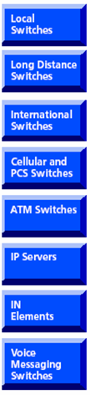
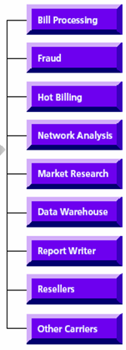
Context of Mediation
MEDIATION
Network
Elements
Usage
Collections
& Activations
Data Processing Unit
Usage
Delivery
& Service
Requests
Business
Application
INPUT from Network Elements
OUTPUT to Downstream Systems
CONFIDENTIAL© Copyright 2007 Tech Mahindra Limited
Notes:
Mediation software is an important piece in the whole telecom business, through which the usage collection and service enabling/disabling is undertaken. Essentially it bridges the network elements on one side and telecom business support systems (BSS) like Billing systems, Rating systems, Usage analysis on the other side.

Slide 38





Mediation Functionalities
1. Collect the CDRs from NE
2. Validate the CDRs
3. Filter the CDRs
Duplicate check
4. Aggregate or Split as per requirement
5. Present CDRs as per
need of Downstream System requirements
Note: Depending on business
requirement , Mediation can be
Configured to perform required
functionalities
6. Route and Distribute the CDRs to the Downstream Systems
CONFIDENTIAL© Copyright 2007 Tech Mahindra Limited

Slide 39
Mediation Challenges
Different Technology
  PSTN, GSM, GPRS, IP ( 1G to 4G)
Different Services
  Voice till VAS
Different Network Elements
  Switches, Routers, HLRs
Different Vendors
  Ericsson, Nokia, Motorola, Alcatel, Lucent, Cisco, Siemens
Different Protocols
  X.25, TCP/IP, FTP, Telnet
Different formats
  Plan Text Vs Binary, Hierarchical Vs Non Hierarchical
Different Interfaces
  Real time Vs Batch
Solution : Convergent Mediation
CONFIDENTIAL© Copyright 2007 Tech Mahindra Limited
Notes:
Convergent Mediation
Different Technology : PSTN, GSM, GPRS, IP ( 1G to 4G)
Different Services : Voice till VAS
Different Network Elements : Switches, Routers, HLRs
Different Vendors : Ericsson, Nokia, Motorola, Alcatel , Lucent , Cisco, Siemens
Different Protocols : X.25, TCP/IP, FTP, Telnet
Different formats : Plan Text vs. Binary, Hierarchical vs. Non Hierarchical
Different Response : Real time vs. Batch

Slide 40



COTS Products in Mediation Space
  USHACOMM
  Pegasus
CMM
COMTEL Eventlink
  OCNM Oracle Comm N/W Mediation
OPNET
FusionWorks
Intec
Intermediate
CONFIDENTIAL© Copyright 2007 Tech Mahindra Limited

Slide 41
Accounting: Payments & Dunning

Slide 42

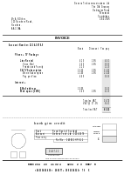



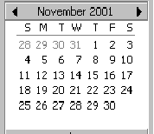
Payment Ballgame
Company
Customer
Account Payables
Cash
Dec 08
Account Receivables
General Ledger
CONFIDENTIAL© Copyright 2007 Tech Mahindra Limited

Slide 43
Payment : Transaction Types
Payments: Full, Partial, Advance
One payment → Multi Invoice
Multi Payment → One Invoice
Deposits and Refund
Transfer of liability
  (Invoices / Payments)
When things go wrong
  Corrections, Adjustments
  Write off
Reports
General Ledger Update
CONFIDENTIAL© Copyright 2007 Tech Mahindra Limited

Slide 44



Preparation for Dunning
Select for Dunning
  All customer invoices with open amounts after due date
  Selection criteria
    By amount
    By date (days after due date)
    By customer group
    By customer code
  Other options
    Deselect specific invoices
    Change dunning fees
    Change late fees
Start Dunning server processes
CONFIDENTIAL© Copyright 2007 Tech Mahindra Limited

Slide 45



When Somebody Does Not Pay in Time
Step 1
A late notice letter
5 days
Step 2
A verification call
7 days
Step 3
Suspension
15 days
Step 4
Cancellation (disconnection)
20 days
Step 5
Referral to collection agency
100 days
Step 6
Write-off the account balance
CONFIDENTIAL© Copyright 2007 Tech Mahindra Limited
Notes:
Write-off - When all collection efforts could not obtain the money owed, the debt is declared as a lost revenue and the debt is written-off.

Slide 46
Revenue Assurance

Slide 47

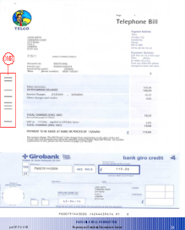

Revenue Assurance
Mantra !!! Prevent or Minimize Revenue Leakage and areas of Fraud
Collection
m1%
Interconnect
m2%
Rating
m3%
Discounting
m4 %
Billing
m5 %
Switch | Raw CDR | Checked | Loss | ... | Loss | Distributed | Loss
Switch 1 | 54913 | 54910 | 3 | 54910 | 0 | 54910 | 0
Switch 2 | 211238 | 211138 | 100 | 211138 | 0 | 211138 | 0
Switch 3 | 1867247 | 1867247 | 0 | 1865247 | 2000 | 1865247 | 0
CONFIDENTIAL© Copyright 2007 Tech Mahindra Limited

Slide 48
Fraud Management: Set Limits
Allows pre-set credit limits at Customer, Account, Service and Plan level
  Setting threshold per day, week or month etc.
Track abnormal usage daily through a node activity report
Action when threshold reached
  Send SMS, Suspend the service for rest of the day etc.
  Send Interim bill
Approach : Prevention is better than cure
CONFIDENTIAL© Copyright 2007 Tech Mahindra Limited

Slide 49
Summary
In this session, you learned:
  Need, goal and features of CRM system
  Functionality of CRM sub system components
  Context of mediation and its functionality
  Billing system composition
  Product and service modeling
  Rating differentiators
  Discounts
  How rating and billing run works
  Payment transactions and dunning actions
  Need of revenue assurance
  Mapping between BSS systems and eTOM model
  Telecom COTS products in BSS area
CONFIDENTIAL© Copyright 2007 Tech Mahindra Limited

Slide 50
Glossary
BSS : Business Support System
eTOM : Enhanced Telecom Operations Map
BSS : Business Support System
CRM : Customer Relationship Management
BI : Business Intelligence
RA : Revenue Assurance
VAS : Value Added Service
CDR : Call Detailed Record
NE : Network Element
SMS : Short Message Service
HLR : Home Location Register
TCP/IP : Transmission Control Protocol/Internet Protocol
FTP : File Transfer Protocol
HTTP : Hyper Text Transfer Protocol
CONFIDENTIAL© Copyright 2007 Tech Mahindra Limited

Slide 51



Any Queries…
&
Questions
Answers
CONFIDENTIAL© Copyright 2007 Tech Mahindra Limited

